Slide 1
1. Formation
a. Weathering
b. Erosion
c. Deposition
d. Compaction
e. Cementation
*LITHIFICATION=process to make sedimentary rocks*

Slide 4
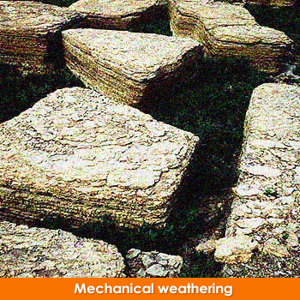
a. Weathering – the breakdown of material at the Earth’s surface.g
i. The weathered material is called
SEDIMENT.

Slide 5

Did you Know?
¾ of rocks on the Earth’s surface are sedimentary?!?!

Slide 6
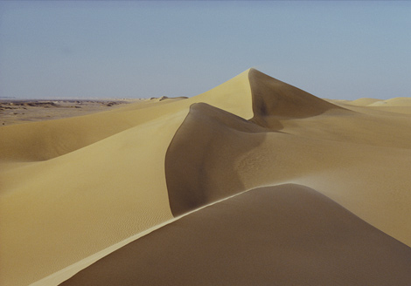
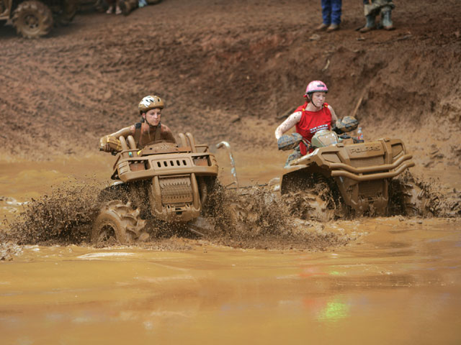
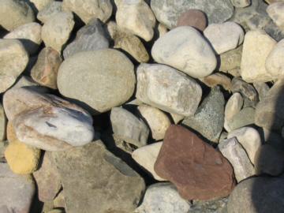
ii. Sediment size varies – mud, sand, gravel

Slide 7
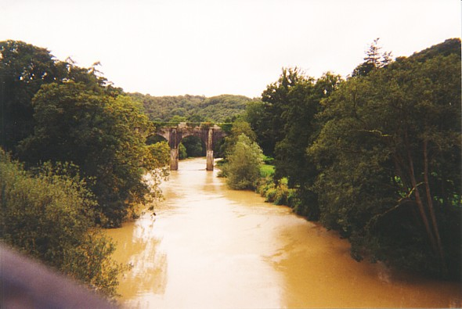
b. Erosion – movement of sediment from on place to another by WIND, WATER, or ICE.

Slide 8
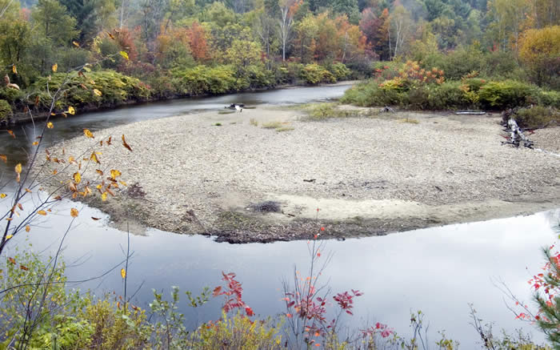
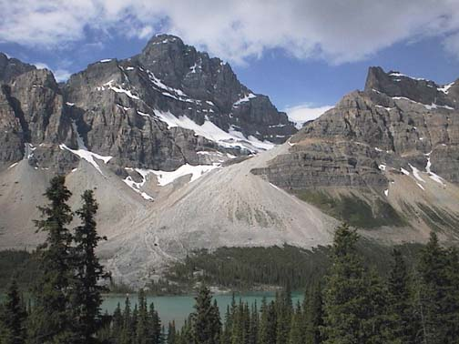
c. Deposition – dropping off the sediment in a new location.

Slide 9
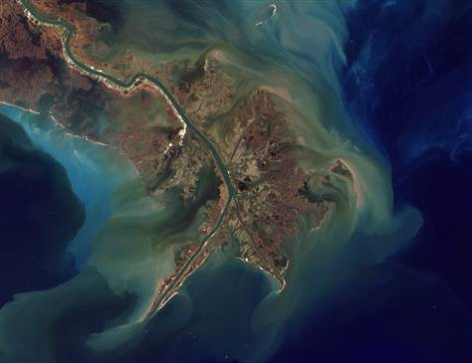
Deposition of the
Mississippi

Slide 10
Now it’s time to put them together!
d. Compaction (Squeezing)
e. Cementation (Gluing)

Slide 11
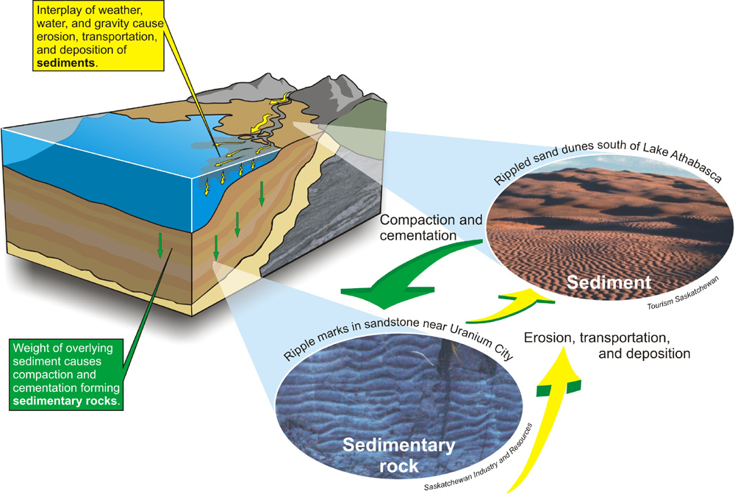

Slide 12
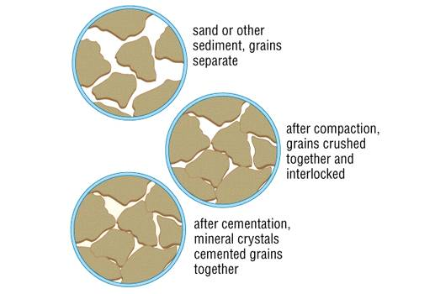

Slide 13
Types of Sedimentary Rocks
Clastic- forms when rock fragments are squeezed together.
Organic- forms when remains of plants and animals are deposited in thick layers.
Chemical-form when minerals that are dissolved in a solution crystallize.

Slide 14

1. Clastic
Made from sediment such as clay, gravel, or sand

Slide 15
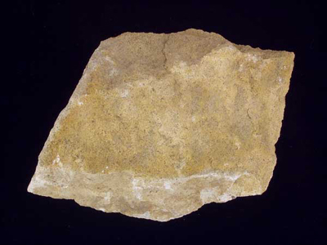
Example: sand becomes sandstone

Slide 16
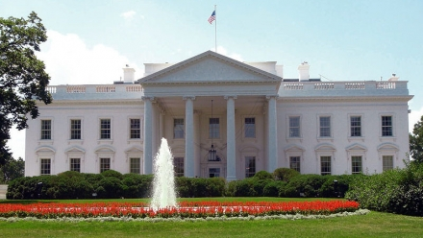
Did you Know?
The white house is built of sandstone!

Slide 17
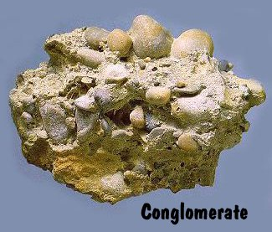
Example: gravel becomes
conglomerate.

Slide 18
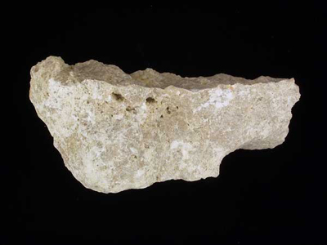
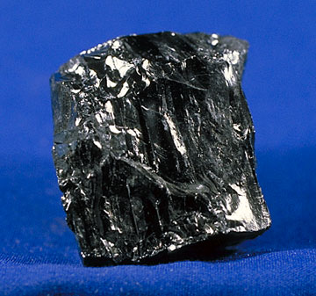
2. Organic sedimentary rock is formed from previously living things.
i. Limestone – ocean life
ii. Coal – plant life on land

Slide 19
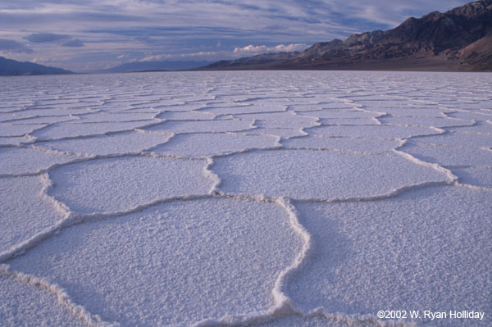
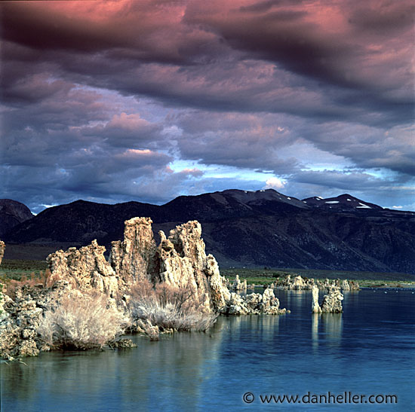
3. Chemical sedimentary rock is formed from a chemical reaction such as water evaporating and leaving rocks behind.

