Slide 1
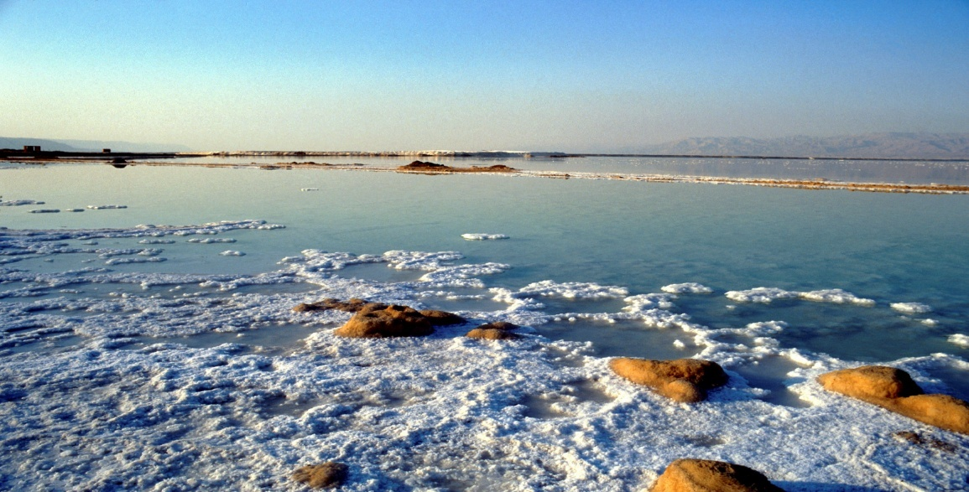
Minerals

Slide 2
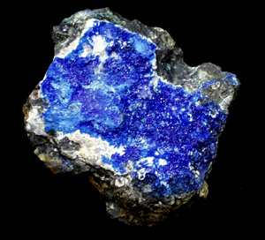
What is a Mineral?
A mineral is a naturally occurring, inorganic solid that has a crystal structure and a definite chemical compound.

Slide 3

1.Found on or in the earth(not man made)
2.Non Living
3.Solid material
4.Has a crystal structure
5.Has a definite chemical composition
Characteristics

Slide 4
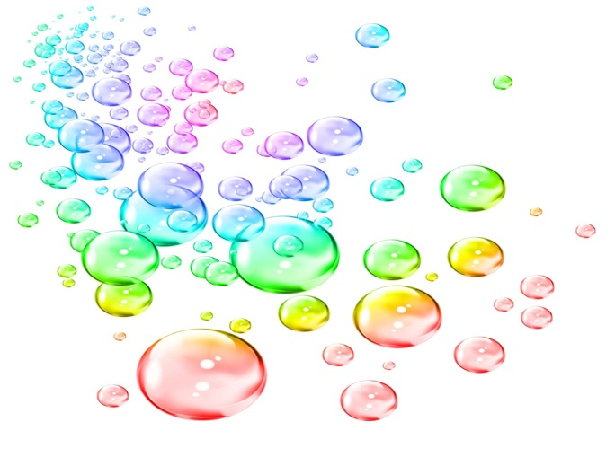
Properties
Cleavage (breaks in a smooth flat surface)
Fracture (curved, uneven, or jagged surface)
Color (color of the mineral)
Streak (color the mineral leaves)
Density (mass per unit of volume)
Texture (smoothness/roughness)
Luster (reflection of light off a mineral)
Mohs Hardness Scale (tests the hardness of minerals)

Slide 5
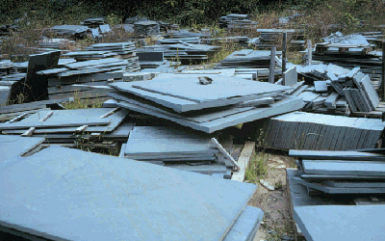
Cleavage
When a mineral breaks in a smooth evenly flat surface

Slide 6
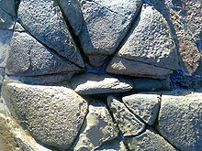
Fracture curved, uneven, or jagged broken surface

Slide 7
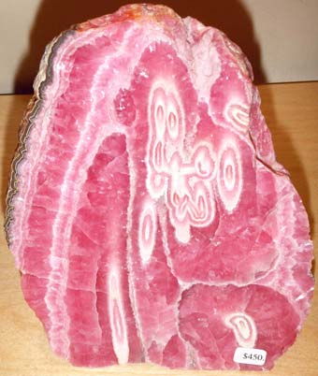
Color
color of the mineral as seen by your eyes

Slide 8
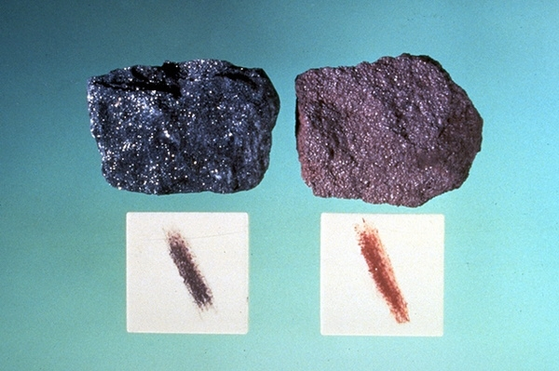
Streak
color the mineral leaves, best way to test the true color of a mineral

Slide 9
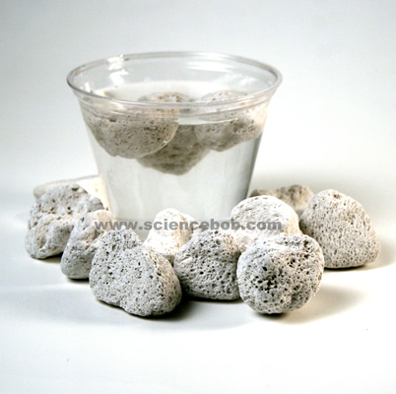
Density
mass per unit of volume

Slide 10
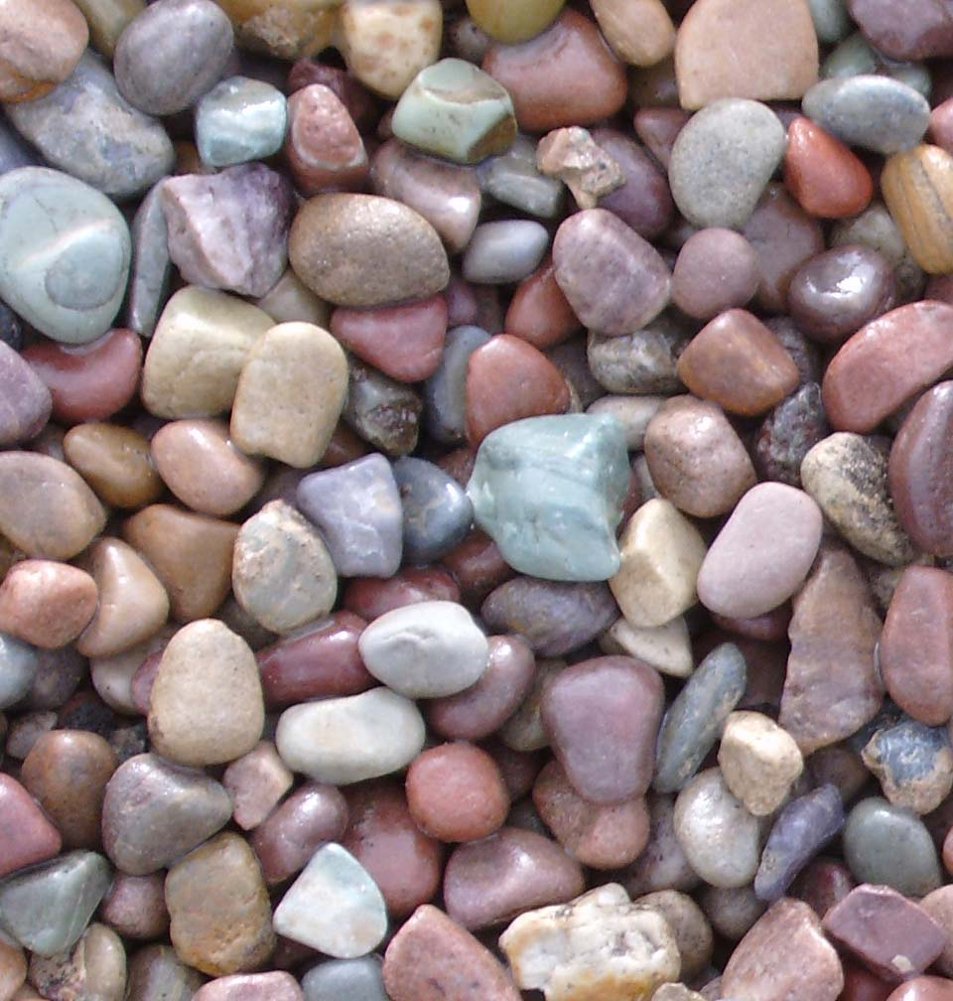
Texture
the smoothness or roughness
of a mineral (to the touch)

Slide 11
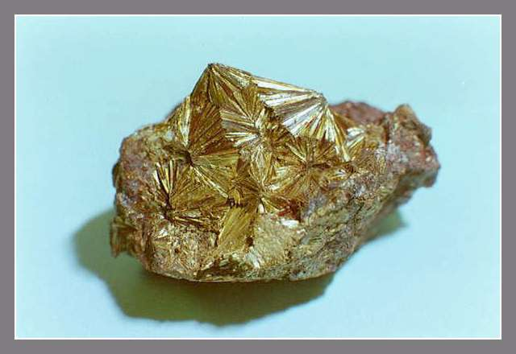
Luster
The reflection of light off a mineral

Slide 12
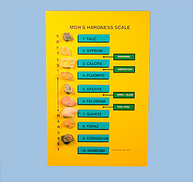
Mohs Hardness Scale
test the hardness of minerals using the following (finger nail, nail, penny, and glass plate)
1-10 scale, with
1 being the weakest
(Talc-weakest)
10 the hardest
(Diamond-hardest)

Slide 13

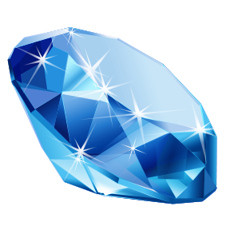
Mineral Resources
Ore-companys can make money from mining it. (iron, copper, aluminum, lead)
Gemstones- minerals mined for their beauty. (diamonds, rubies, emeralds)

